Slide 1



Data Mining – Sofa Score
Scraping soccer data by Daniel and Sagi

Slide 2
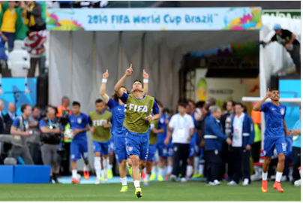
Entering The Field
Website and Scraping
Designing the Database
Enriching the Database
Visualizing insights
From ideal to real

Slide 3
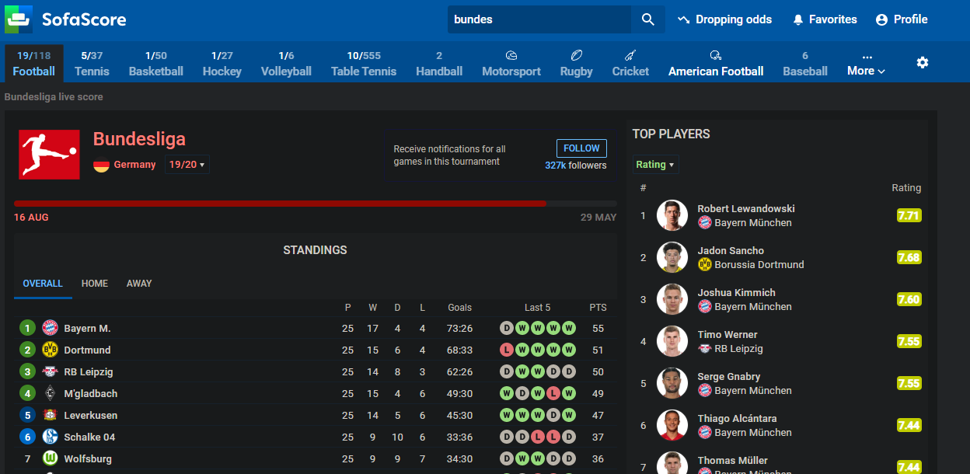
Website and Scraping
Leagues data:
Scraped data out of the 4 big leagues
Got the team URL's
Notes:
This page is the main page of the league, we have 4 of those, and from this kind of pages we scraped all the team belonging to the league.
We used selenium for this kind of pages since the tables are loadad with javascript code which we werent able to reach using only bs4.
The leagues are the one to be scraped via the CLI with flags by league name.

Slide 4
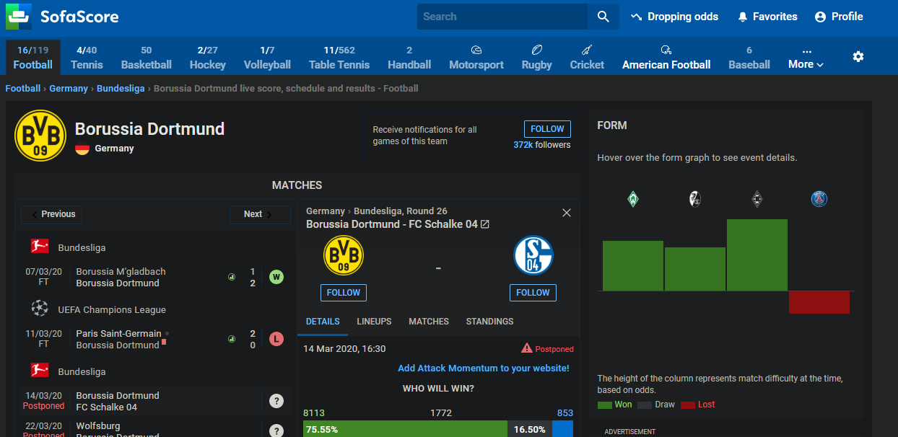
Website and Scraping
Teams data:
Scraped data out of the 4 big leagues
Got the players URL's
Notes:
From the teams pages we scraped the managers and players urls, same issue here with the javascript code that load the info for the user, so we used selenium again. 2300 URLS totally
78 teams

Slide 5
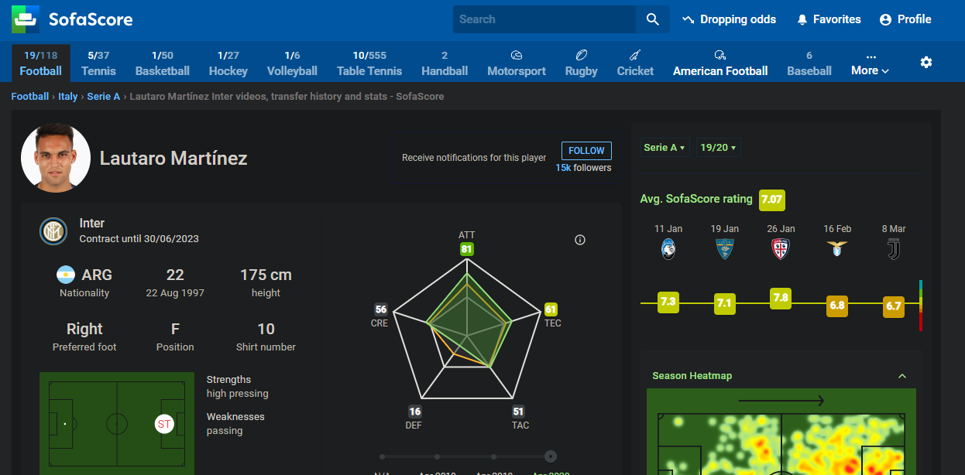
Website and Scraping
Players data:
Scraped 2200 soccer players pages
Basic information: name, birth-date, height, etc..
Notes:
This is the players page, here bs4 was enough and we were able to fetch each player desire

Slide 6
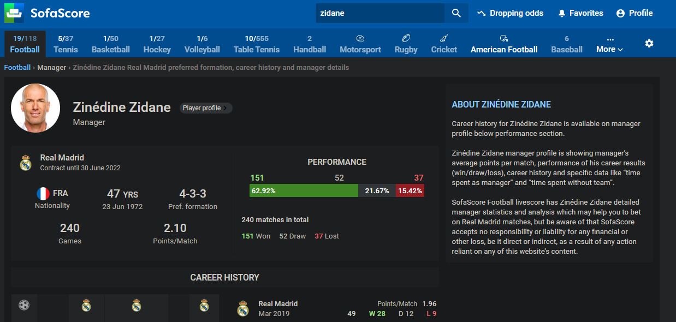
Website and Scraping
Managers data:
Scraped 78 managers, as there is one per team
Basic information: name, birth-date, formation, etc..
Notes:
This is the manager page, same goes as in player pages.

Slide 7
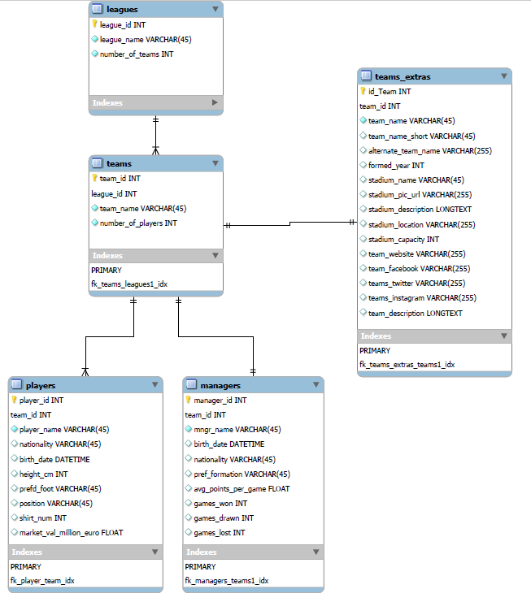
Designing the Database
Created 5 tables
Tried to mimic real life structure
Stored data about: - leagues
- teams (sofa-score and an external API)
- players
- managers
Stored several types of data – INT, REAL, DATETIME, VARCHAR, LONGTEXT
Used auto-increment for the keys
Used foreign keys to have a connection between the tables
Notes:
This is the design of our modest database, it is built from 5 tables, that try to describe the reality, the real structure of a club, *** explain fields and types we scraped ***
We had 3 tables in the second checkpoint, managers and teams extras were added in the third checkpoint, while team exstras is from external api.

Slide 8
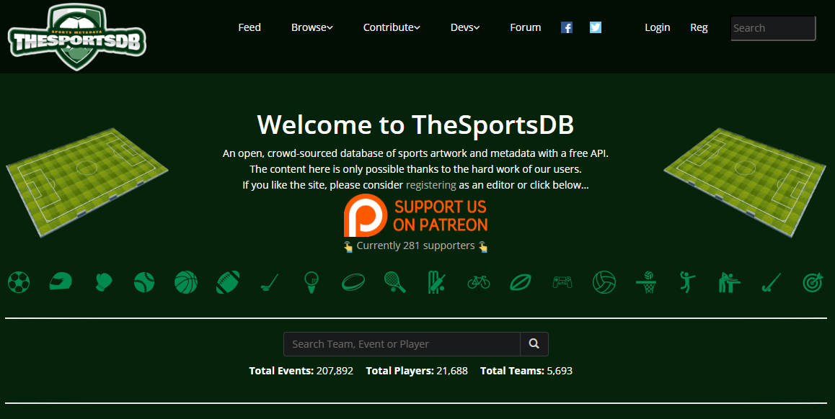
Enriching the Database
Used the free API – thesportsdb.com
We decided to enrich the data about the team
Created the table – “teams_extras”
Got additional information about the team stadium, team foundation year, etc…
Got a JSON text using the team name in the URL
Notes:
Used thesportsDB API which is totally free. We scraped more data about each team – stadium capacity, descripitions, year formed tec.. This table is connected by a foreign key to the original teams table.
This API generates for us a JSON text which is very comfortable to work with.

Slide 9
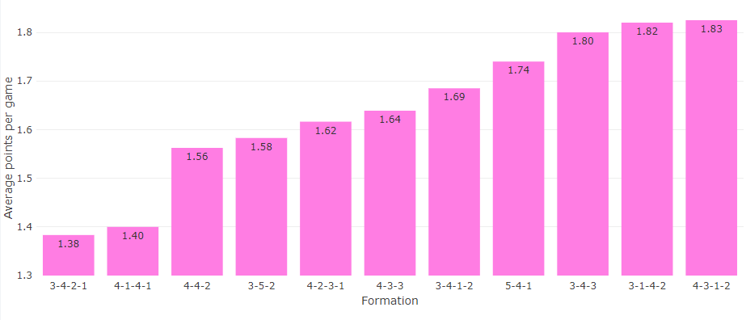
Visualizing insights
Grouped by all preferred formations and compared the average point per game
Notes:
Finally we connected the project to the AWS and to redash, and visualize our data!
Trying to get some insights about european soccer, we can see in this plot the average points per game with the respect to the preferred formation by each manager.

Slide 10
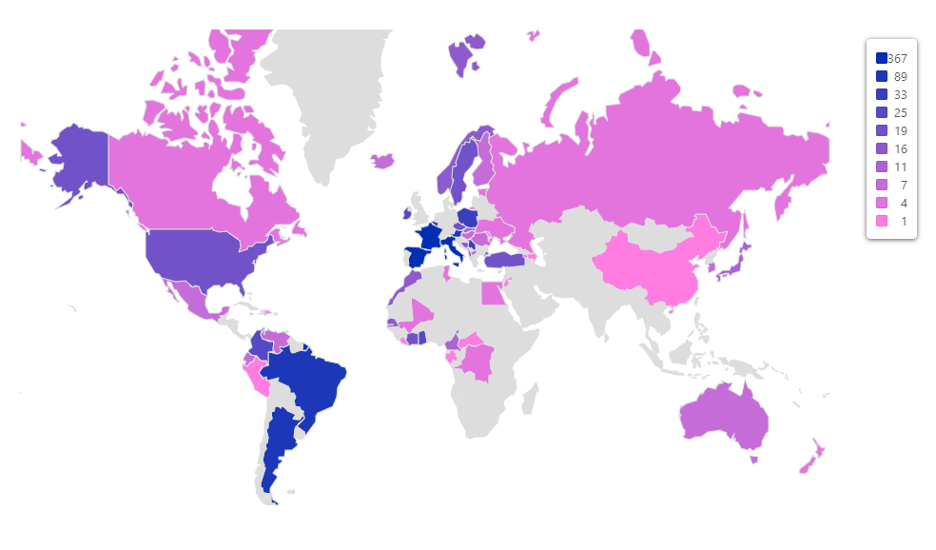
Visualizing insights
Count of players by nationality
Notes:
In this map we are presenting the count of players by their origin, we can see that most of the players in the 4 big leagues are from south america and europe.

Slide 11
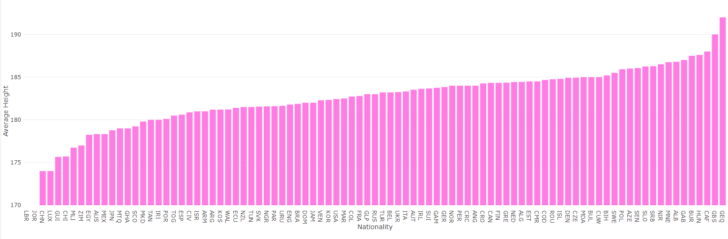
Visualizing insights
Height by nationality
Notes:
This is the average height of the players grouped by their nationality. We can see that we are missing height values for LBR- which is liberia and JOR – which is jordan. The talles country appears to GEQ – which is equatrial guinea.

Slide 12
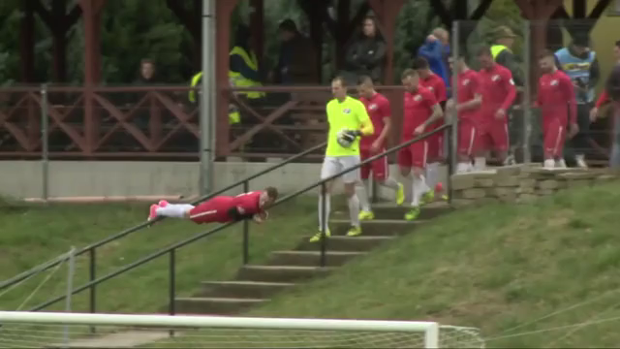

From Ideal To Real
Problem encountered:
The site changed on the go (3 times (till now!!!))
Special characters to be encoded
Differences in team names when calling external API
Chromedriver obviously
Notes:
While scraping the data sofa-scored us, and did some frequent updates to the site html (in the last couple of weeks – probably they have free time since the sports are off)
And we had to to changes from checkpoint to checkpoing in our scraper adjusting according to the new site design.
When trying to scrape on the server we encounterd issue with special characters – mainly cirillic letters in eastren european players and managers, we adrressed the problem by encoding those characters to english
before commiting them to the database.
When calling to the api we had some differences between the exact team name (in german league espcially) for example in sofascore bayern munich is called bayern munich and in the api its called just bayern.
We had problem with chromedriver like the most of us did, for us, we stayed with the chrome and did not change to firefox, as installing the right version on chrome in the AWS worked just fine.

Slide 13

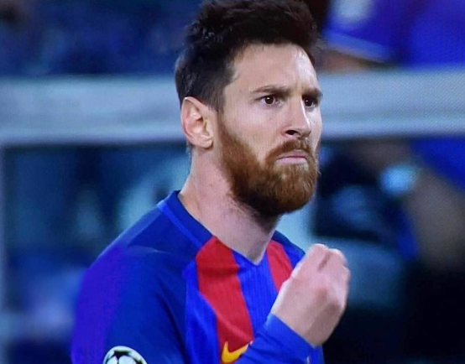
Questions
Thank You!

